Slide 1

Student Placement Data
Group F:
Arjun Singh Pathania
Neha Jagtap
Nikhil Deore

Slide 2
INTRODUCTION Placement data includes 1.gender 2.secondary education percentage 3.board of education 3.higher secondary education percentage 4.board of higher secondary education 5.Specialization in higher secondary education 5.Degree percentage 6.Undergrad degree 7.Undergrad percentage 8.Work experience 9.MBA 10.MBA percentage 11.status 12.salary

Slide 3
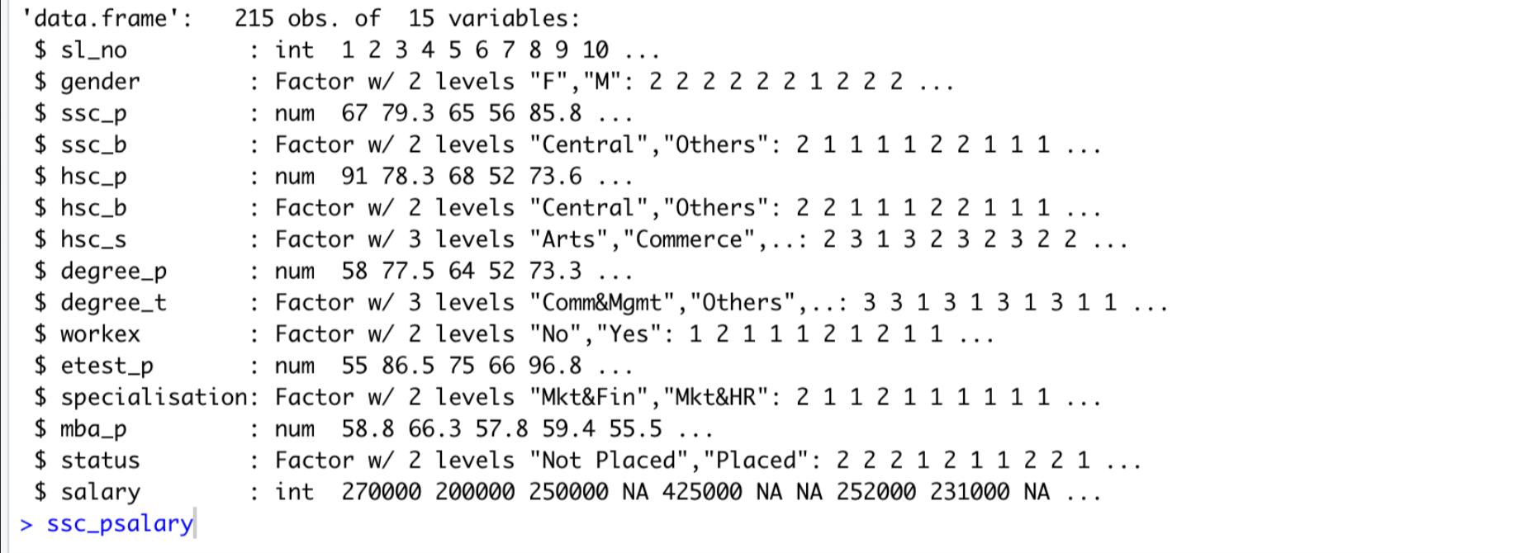
DATA SPECIFICATIONS

Slide 4
Prediction
Prediction depends on
1.Academic Performance
2.Skills and Experience
3.Industry Demand
4.Knowledge

Slide 5
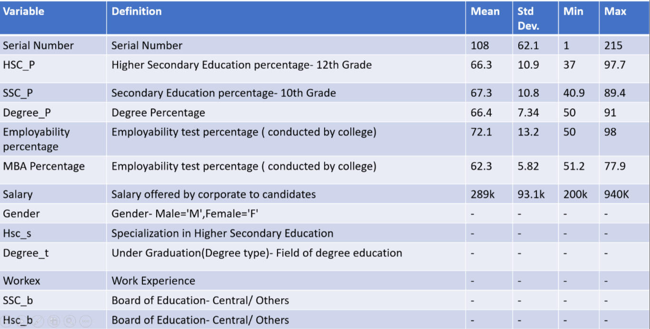
EACH VARIABLE STATISTICS

Slide 6
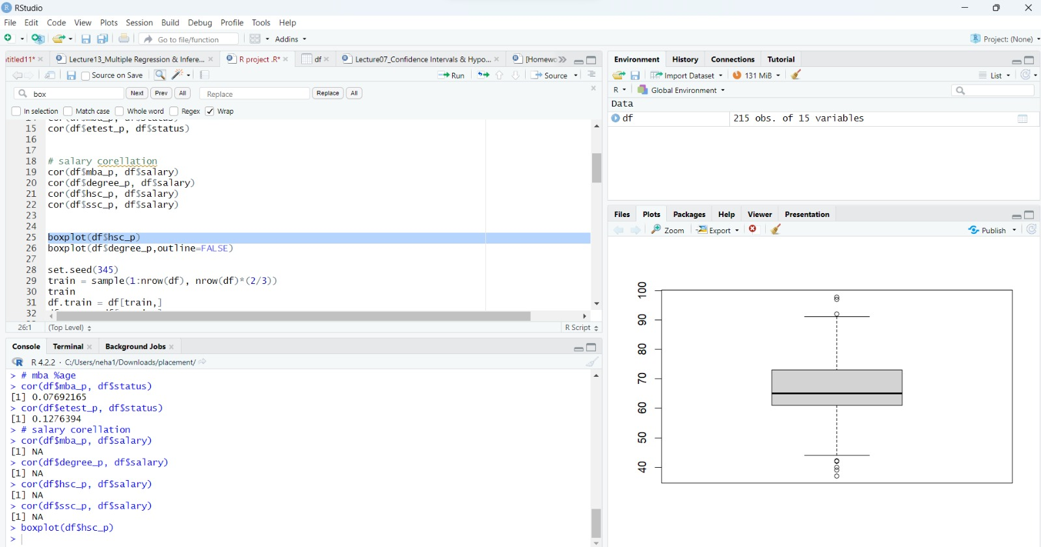
OUTLIER DETECTION USING BOX PLOT
The average percentage of HSC students is between 60 to 80.
The outliers lie below 40% and above 90%

Slide 7
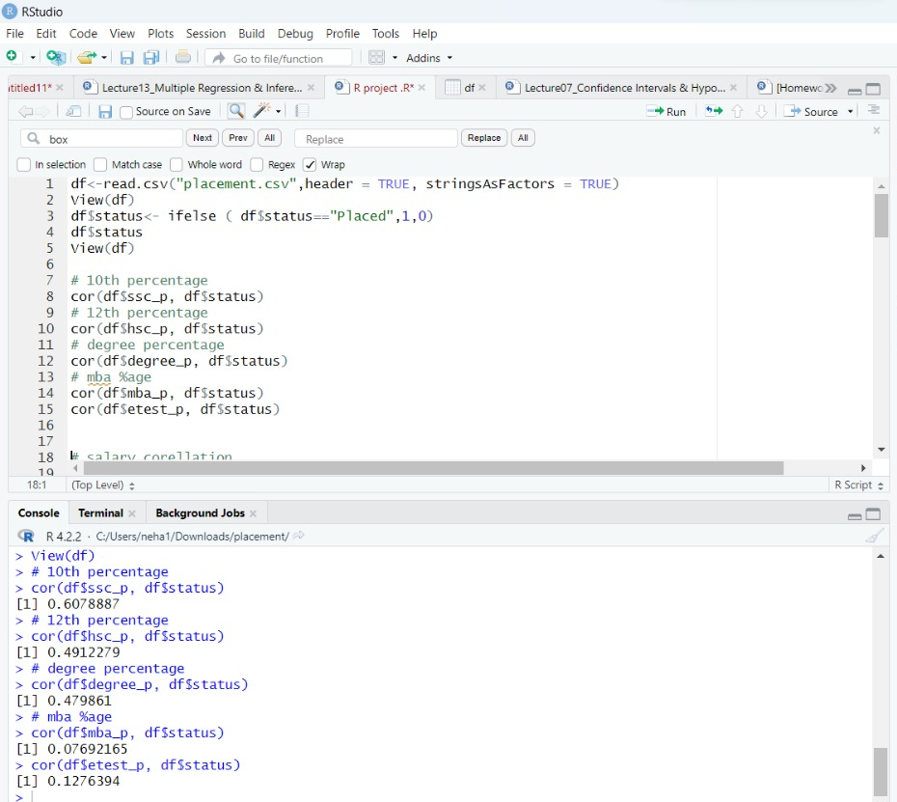
CORRELATION MATRIX BETWEEN VARIABLES
Correlation Between SSC Percentage And Status Is 60.78%
Correlation Between HSC Percentage And Status Is 49.12%
Correlation Between Degree Percentage And Status Is 47.98%
Correlation Between MBA Percentage And Status Is 07.69%
Insight:
SSC Percentage Plays The Major Role In Placements Status. Although MBA Is An Important Degree The Number Of Students Pursuing MBA Is Comparatively Less That The Number Of Students Appearing For SSC(10th) Exam.

Slide 8
INDEPENDENT VARIABLE SPECIFICATION
The status of placement depends on all the factors including ssc percentage, HSC percentage, mba percentage and degree percentage

Slide 9
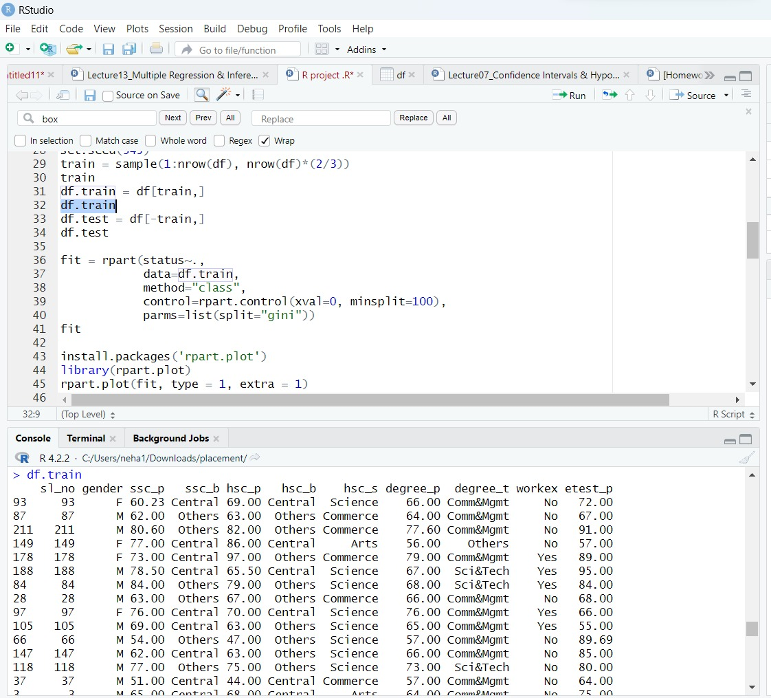
SPLITTING THE DATA INTO TRAINING DATATSET
The data is separated into 2 datasets. The training dataset consists of 2/3rd of the total data which is 215 rows.

Slide 10
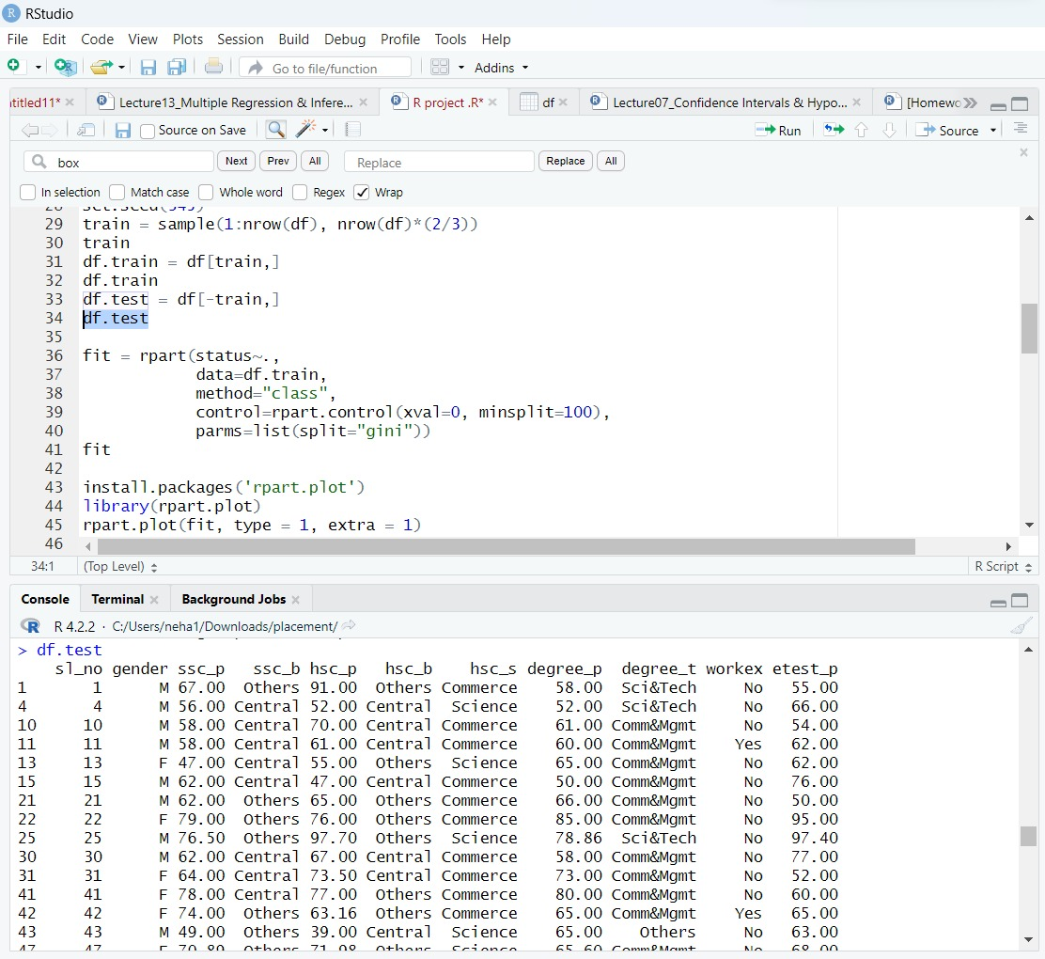
SPLITTING THE DATA INTO TEST DATA
The data is separated into 2 datasets. The testing dataset consists of 1/3rd of the total data which is 215 rows.

Slide 11
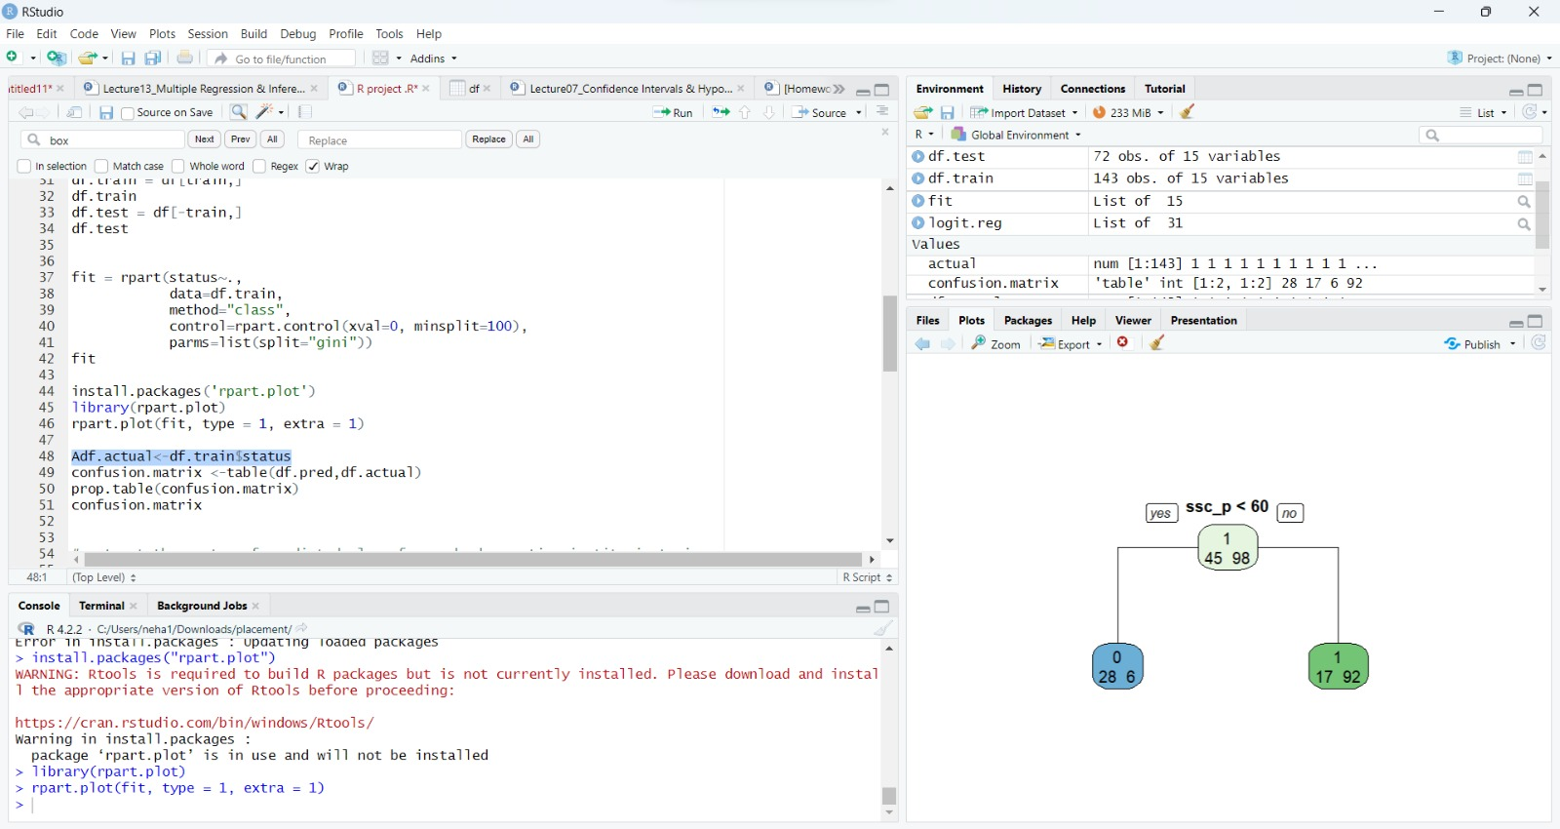
GROWING A TREE AND DISPLAY BASIC RESULTS
SSC percentage is the determining factor for decision tree
Decision tree is divided into two categories below and above 60%.

Slide 12
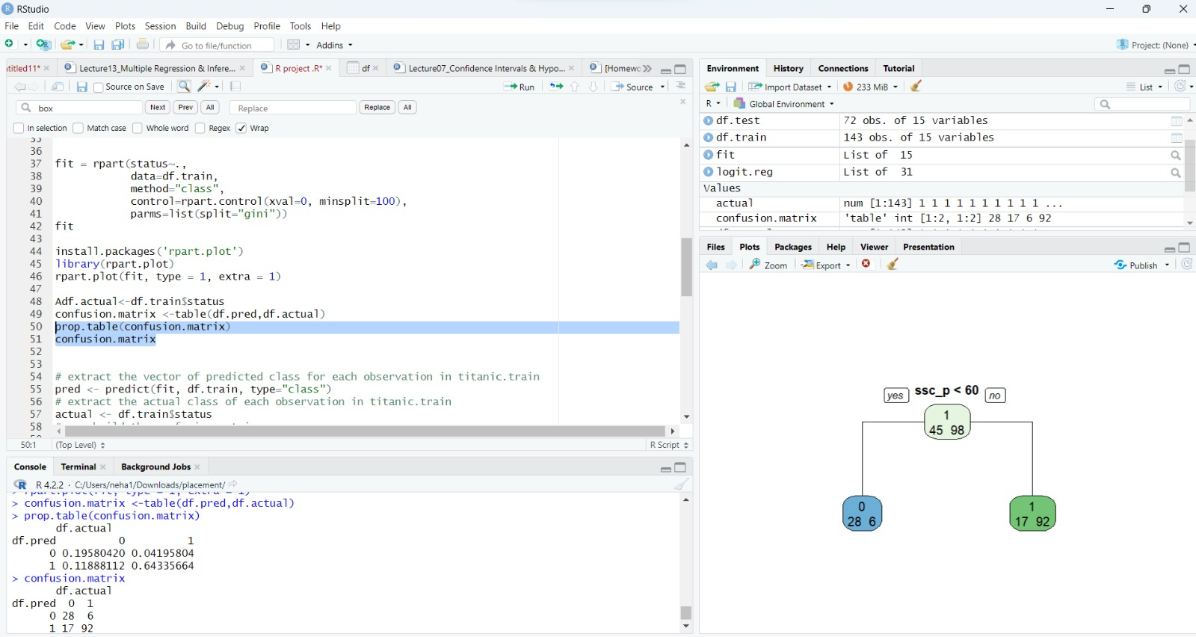
PLOTTING A TREE AND MAKE AN INTERPRETATION
In this we have found the confusion matrix for decision tree
Positive values for decision tree are 45(28+17)
Negative values for decision tree are 104 (98+06)

Slide 13
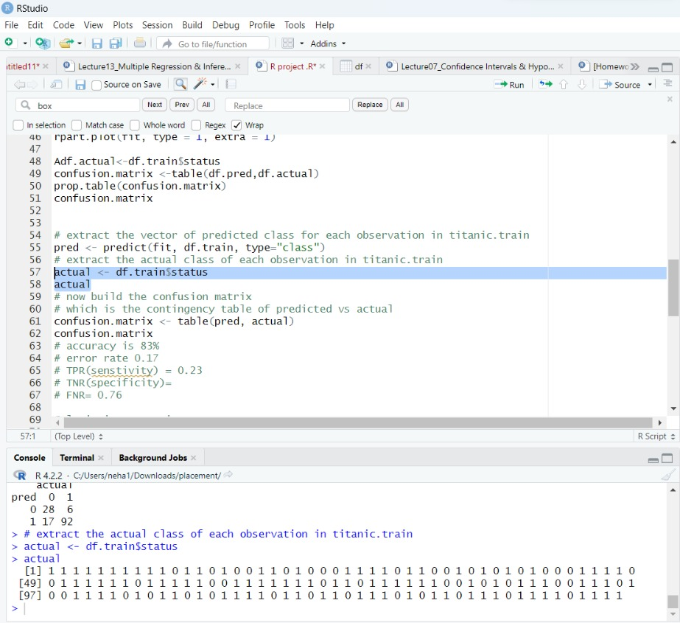
ACCURACY ON THE TRAINING DATA
After finding the confusion matrix the accuracy of the training dataset is 83% and the error rate is 17%

Slide 14
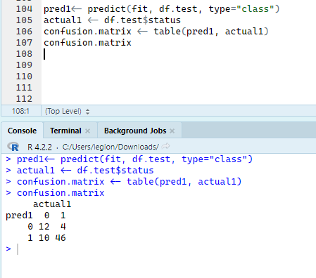
ACCURACY ON THE TESTING DATA
After finding the confusion matrix the accuracy of the testing dataset is 80.55% and the error rate is 19.45%

Slide 15
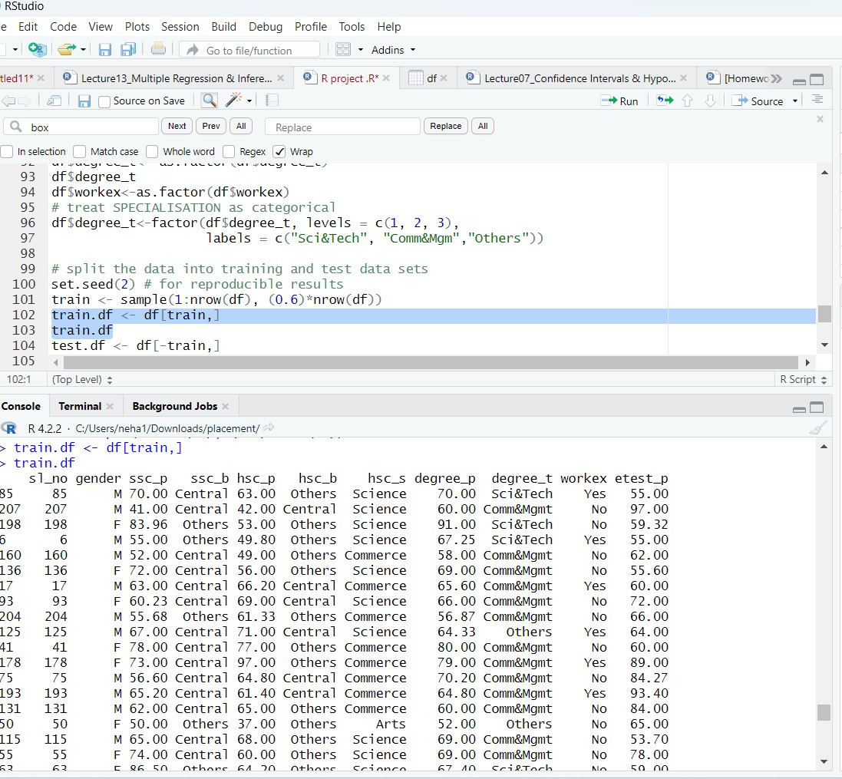
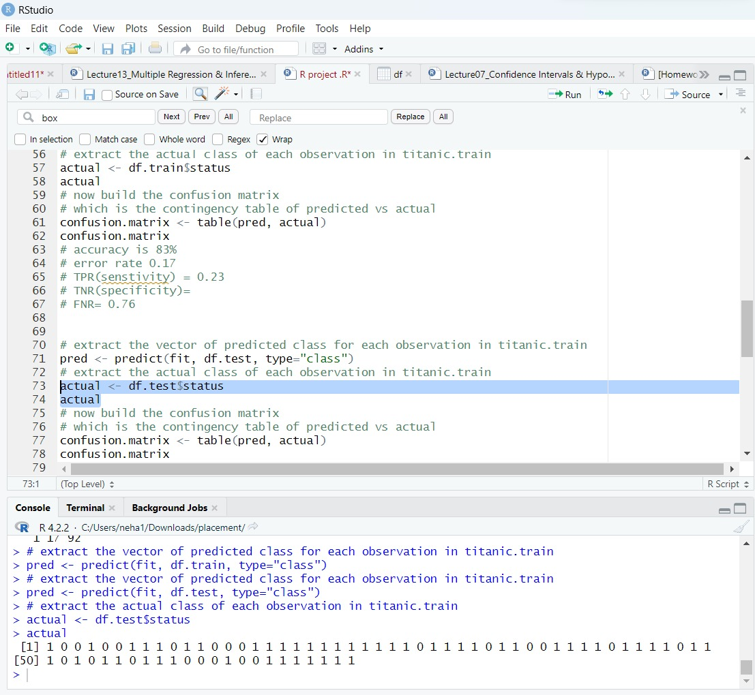
SPLITTING TRAINING AND TESTING DATASET
The data is separated into 2 datasets. The training dataset consists of 1/3rd of the total data which is 215 rows. The training dataset consists of 1/3rd of the total data which is 215 rows.

Slide 16
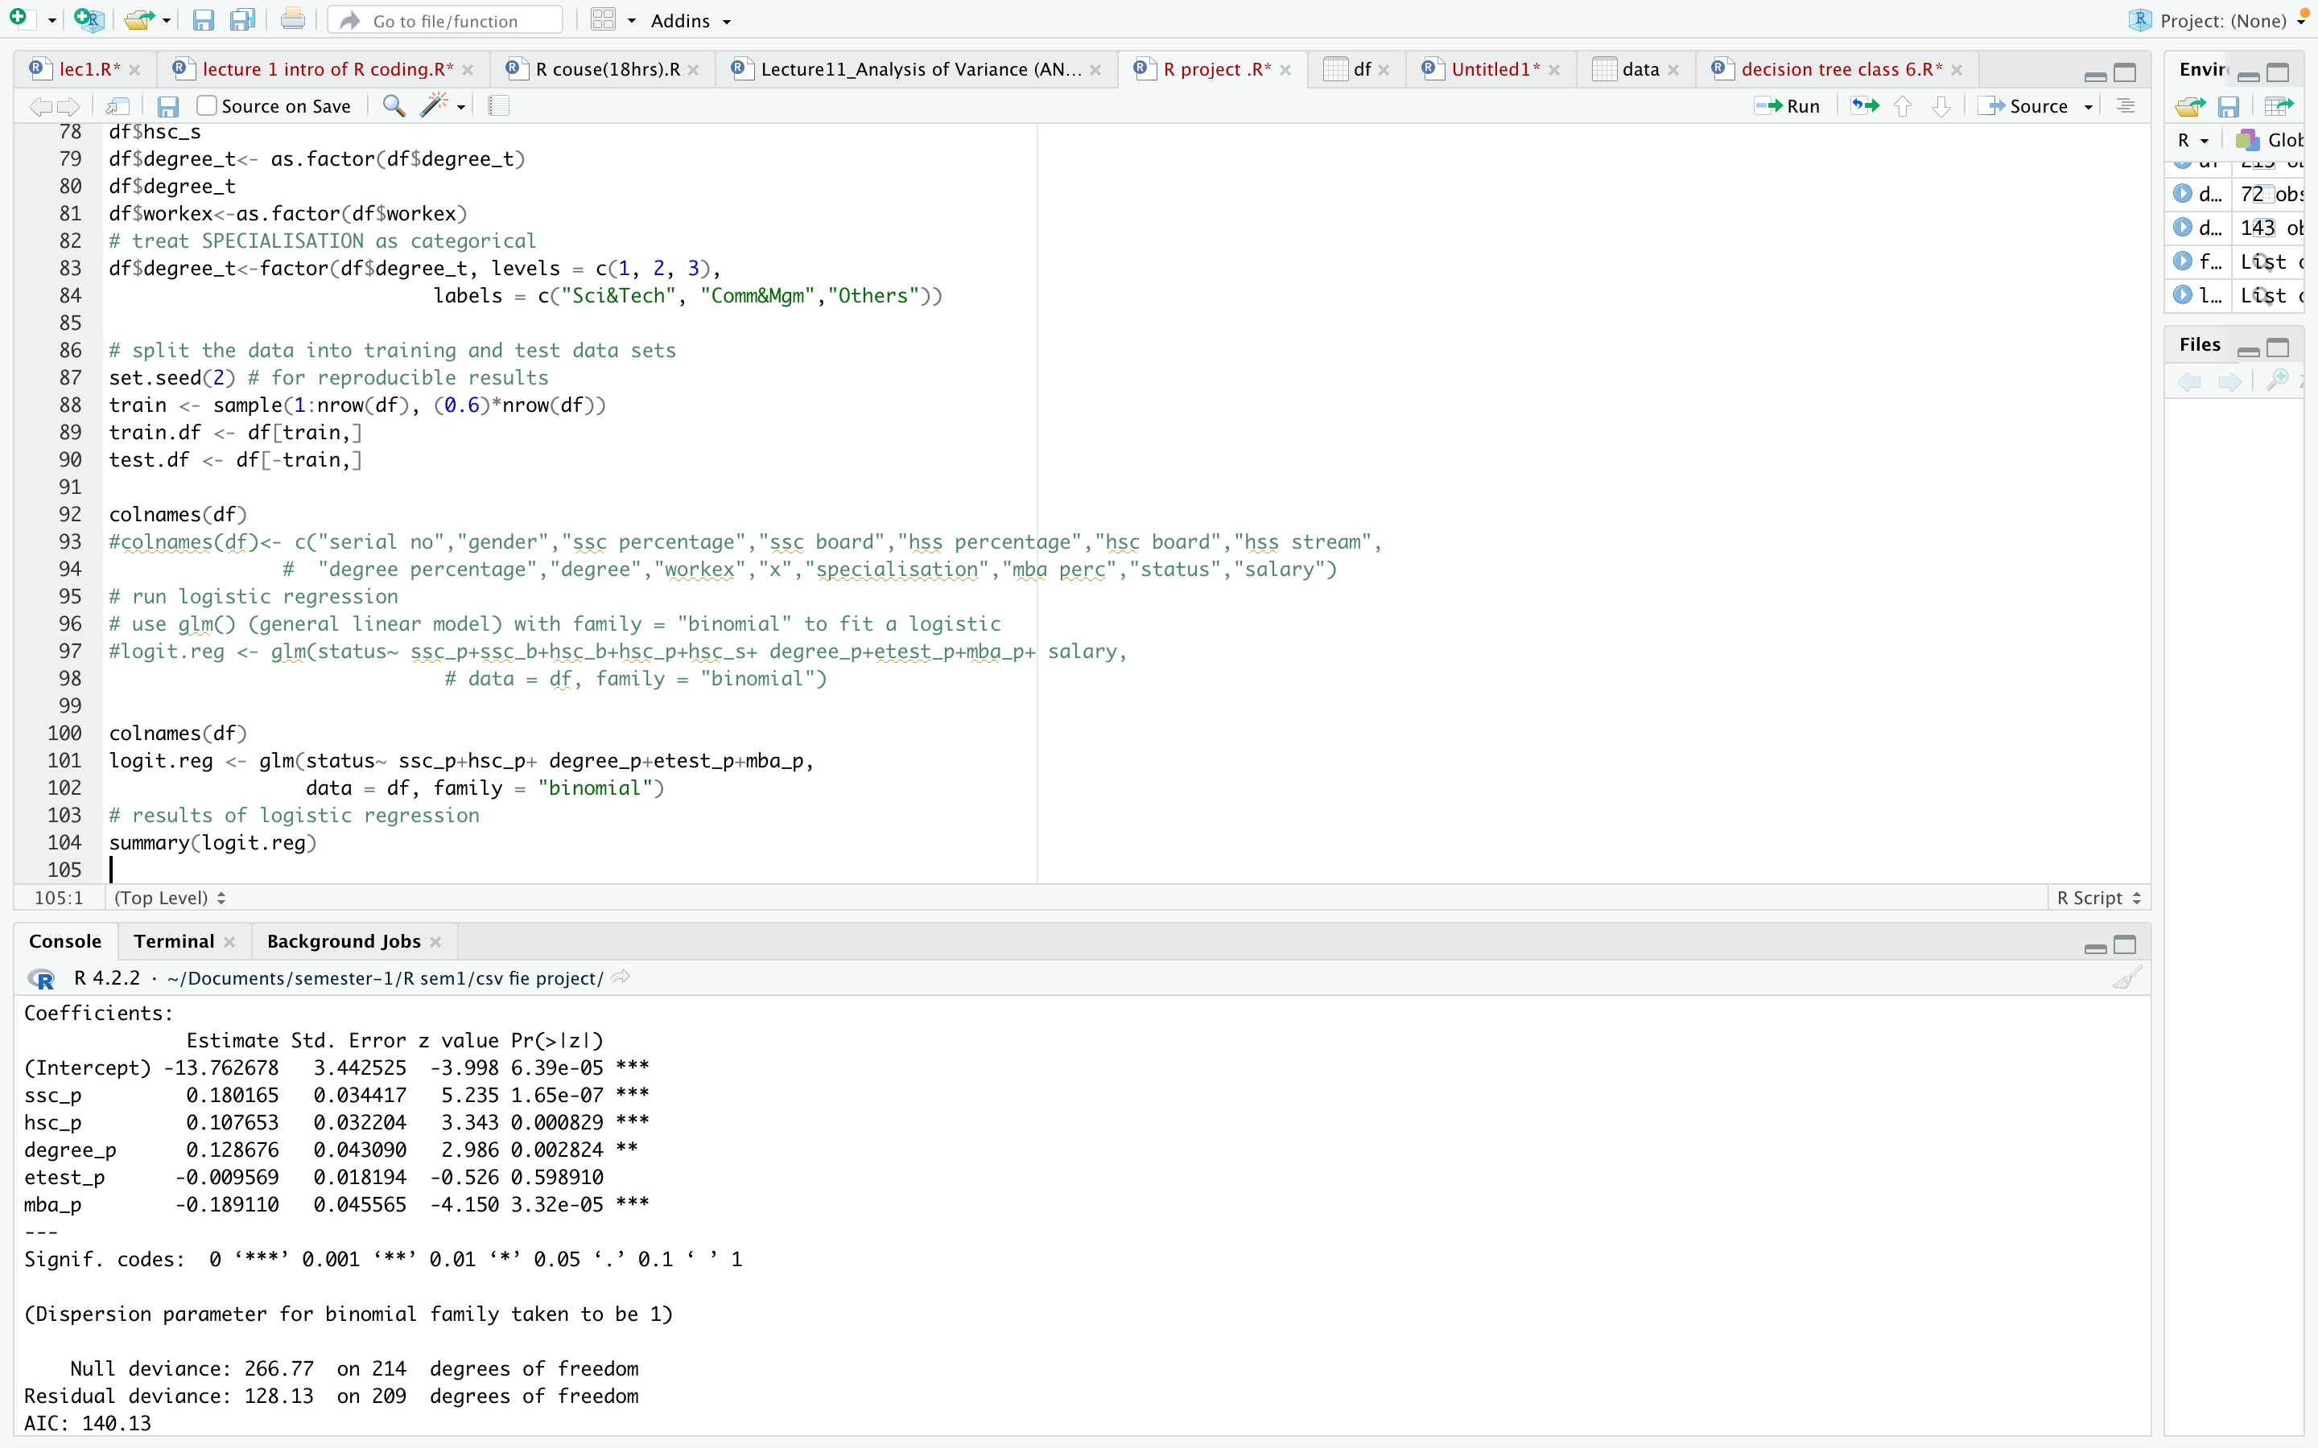
LOGISTIC REGRESSION AND DISPLAY THE RESULTS
The most significant column to determine whether the person is placed or not is ssc_p, hsc_p and mba_p

Slide 17
INTERPRETATION OF SIGNIFICANCY AND COEFFICIENT
The most significant column to determine whether the person is placed or not is ssc_p.
The coefficient of ssc_p is 0.180 which is the highest amongst all

Slide 18
ACCURACY ON THE TRAINING DATA
After finding the confusion matrix the accuracy of the training dataset is 83% and the error rate is 17%

Slide 19
ACCURACY ON THE TESTING DATA
After finding the confusion matrix the accuracy of the testing dataset is 80.55% and the error rate is 19.45%

Slide 20
INTERPRETATION
The determining factor for placement using Correlation is SSC percentage and MBA percentage plays a very little role.
While performing logistic regression mba percentage is a very significant factor as compared the SSC percentage.

Slide 21
Any Questions? Thank You

